Slide 1
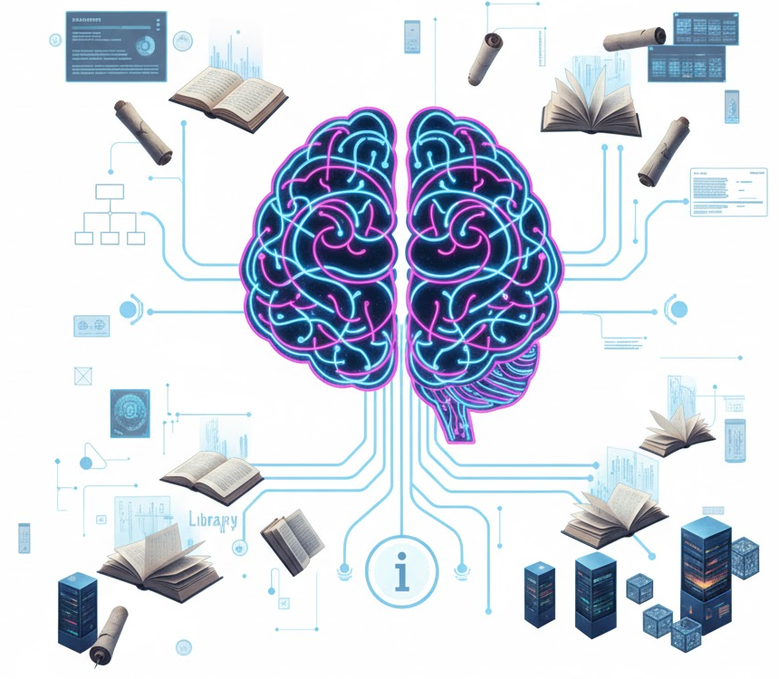
Enhancing Factual Grounding with Retrieval-Augmented Generation (RAG)
Combating Hallucinations and Stale Knowledge in Large Language Models
Roll No.: 16010422234
Name: Chandana Ramesh Galgali
Course: HO-NLP

Slide 2
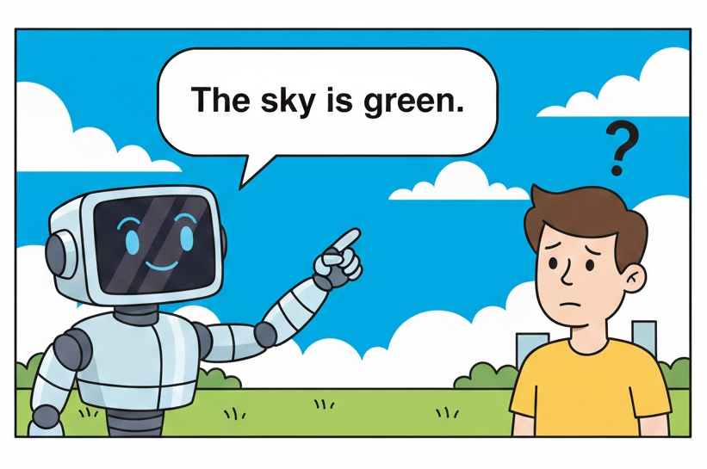
The Limits of Parametric Knowledge
Large Language Models (LLMs) store vast knowledge in their parameters, but this "parametric memory" has critical flaws.
Hallucinations: Models often generate plausible-sounding but factually incorrect or nonsensical statements. They confidently "make stuff up".
Stale Knowledge: The model's knowledge is frozen at the end of its training. It cannot be updated with new, real-time information without costly retraining.
Lack of Transparency: It's difficult to trace where an answer came from, making it hard for users to verify claims or trust the output.

Slide 3
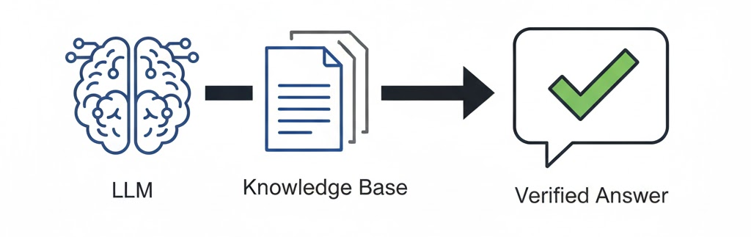
A Hybrid Approach for Smarter,
More Reliable AI
RAG is a framework that enhances LLMs by connecting them to an external, authoritative knowledge base before generating a response.
It combines the LLM's broad parametric knowledge with verifiable, non-parametric knowledge from a source you control (e.g., company documents, a specific database, or the live web).
The goal is to ground the LLM's response in factual, up-to-date context, making it more accurate and trustworthy.

Slide 4
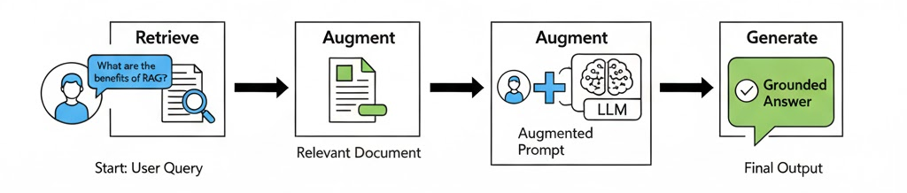
From Query to Grounded Answer
RETRIEVE: When a user asks a question, the system first searches an external knowledge base for relevant information. This is done using semantic search, which understands the meaning of the query, not just keywords.
AUGMENT: The most relevant retrieved information (or "context") is then combined with the original user prompt. This creates a new, enriched prompt that gives the LLM the facts it needs.
GENERATE: This augmented prompt is fed to the LLM. The model uses the provided context to synthesize a final answer that is grounded in the retrieved data, rather than relying solely on its internal memory.

Slide 5
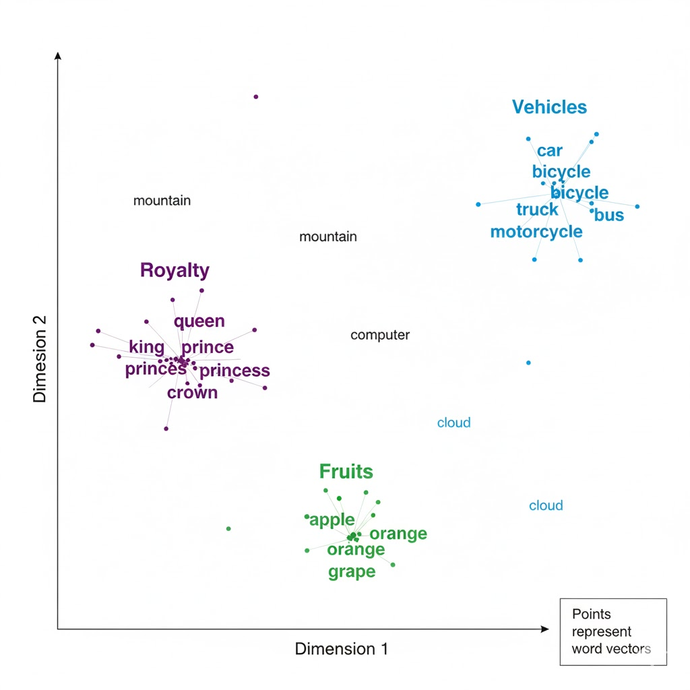
Finding Meaning in Data
The "retrieval" step is powered by vector embeddings.
Text from documents and the user's query are converted into numerical representations (vectors) that capture their semantic meaning.
The system finds documents whose vector embeddings are mathematically "closest" to the query's vector. This means they are the most similar in meaning.
This is far more powerful than simple keyword matching.

Slide 6



Why is RAG a Game-Changer?
Improves Factuality: Drastically reduces hallucinations by grounding responses in verifiable evidence. Models generate more specific and factual language.
Enables Knowledge Updates: The model's knowledge can be kept current by simply updating the external document database—no expensive retraining required.
Builds Trust & Transparency: RAG can cite its sources, providing "provenance" for its answers. This allows users to verify the information and trust the system's outputs.

Slide 7
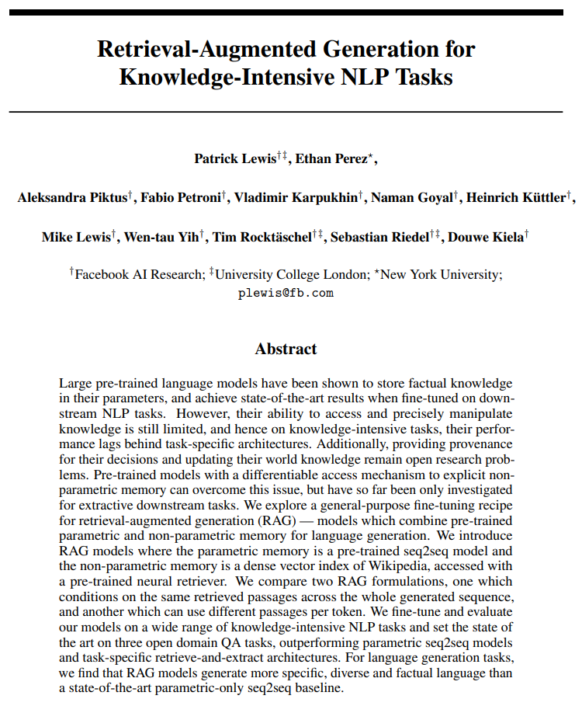
A Shift in the Role of the LLM
The RAG framework was formally introduced in the paper "Retrieval-Augmented Generation for Knowledge-Intensive NLP Tasks" (Lewis et al., 2020).
This research proved that RAG models could achieve state-of-the-art results on open-domain question answering tasks.
Impact: RAG reframes the LLM from being an all-knowing (but flawed) oracle into a powerful reasoning and synthesis engine. It creates a division of labor:
The Retriever: Acts as an expert librarian.
The LLM: Acts as a skilled scholar who interprets the librarian's findings.

Slide 8
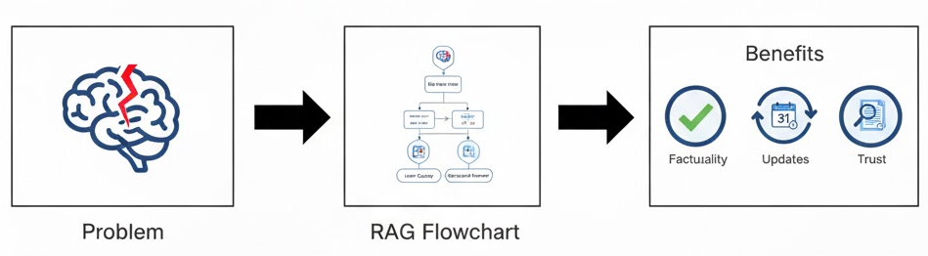
Summary and Future Directions
RAG is a practical and powerful solution to the core weaknesses of today's LLMs.
It makes AI systems more reliable, trustworthy, and ready for real-world applications where facts matter.
The future of RAG includes more advanced retrieval strategies, multi-modal capabilities (retrieving from images and tables), and further optimization for speed and efficiency.

Slide 9
References
P. Lewis, E. Perez, A. Piktus, F. Petroni, V. Karpukhin, N. Goyal, H. Küttler, M. Lewis, W. Yih, T. Rocktäschel, S. Riedel, and D. Kiela, "Retrieval-Augmented Generation for Knowledge-Intensive NLP Tasks," in Advances in Neural Information Processing Systems, 2020.

